Slide 1
WEARABLE GLOVE FOR TRANSLATE SIGN LANGUAGE INTO TEXT AND SPEECH

Slide 2


FINAL YEAR PROJECT
Panimalar Engineering College
Dept: Mechanical Engineering
Year: 4th
Group No: 34
Dept: Mechanical
Project Head
Mr. J.Gunasekaran
Project Members
R.Naresh Kumar
Prasanna Balasubramanian
Rohit.K

Slide 3
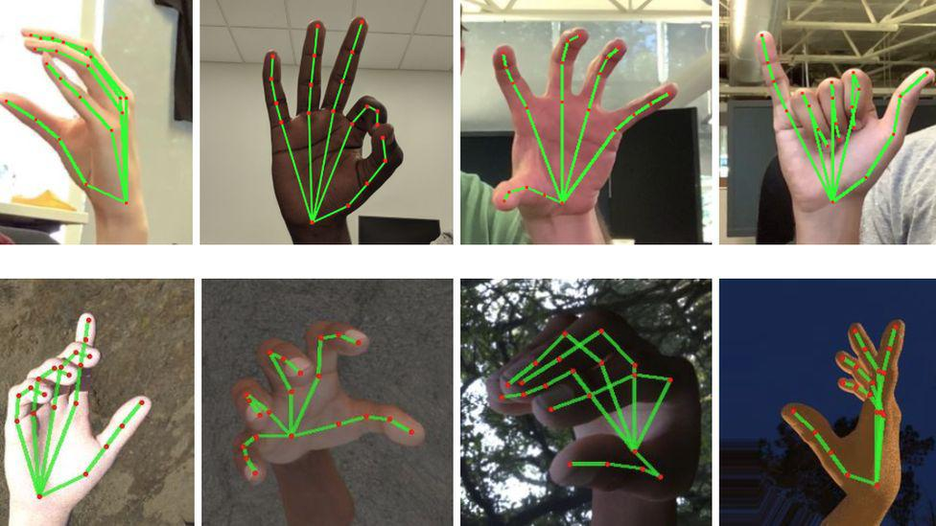
AIM OF PROJECT
Our main aim is to design a glove that translates sign language into text and speech.

Slide 4
ABSTRACT
Dumb and deaf persons make up a large portion of India's population. As a result, the system is developing a glove-based device for converting ASL to speech. The basic system is divided into 2 parts recognition of sign language and conversion to text, followed by voice. The sign language glove is made up of a pair of basic hand gloves with mems sensors that detect how much the hand moved. The sensors that increase resistance based on the degree of bend on the sensor are known as mems sensors.

Slide 5
ABSTRACT
Data from the sensors is sent to the Arduino control unit, where the analogue signals are digitally transformed and compared to the recorded value for sign detection, and then displayed as text on the display. Also, Persons who are deaf or hard of hearing communicate with society using sign languages that are difficult to interpret by non-deaf or hard of hearing people. As a result, communication between deaf-mutes and non-mutes has always been a challenge. Everywhere in the world, there are difficult tasks.

Slide 6
INTRODUCTION
India constitutes around 2.4 million of Deaf and Dumb population. These people lack the amenities which a normal person should own. This decreasing ratio of Literate and Employed Deaf and Dumb point population is a result of the physical disability of hearing for deaf people and disability of speaking for dumb people so it yields to lack of communication between normal person and Deaf and Dumb Person. It actually becomes the same problem of two persons which knows two different language, no one of them knows any common language so its becomes a problem to talk with each other and so they requires a translator physically which may not be always convenient to arrange and this same kind of problem occurs in between the Normal Person and the Deaf person.

Slide 7
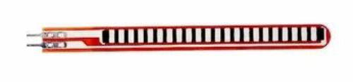
EXISTING SYSTEM
In existing system, there is no circuit is used to announce their thoughts of physically challenged peoples. In existing method is sign language, it couldn't understand all people for communication. There after a circuit is used to design predetermined postures are captured and matching the captured image with deaf & dump peoples sign language using a Flux sensor.

Slide 8
DISADVANTAGES
Processing time is high.
The Flux Sensor Breaks easily and it’s life time is less.
Accuracy level depend upon Human error.

Slide 9
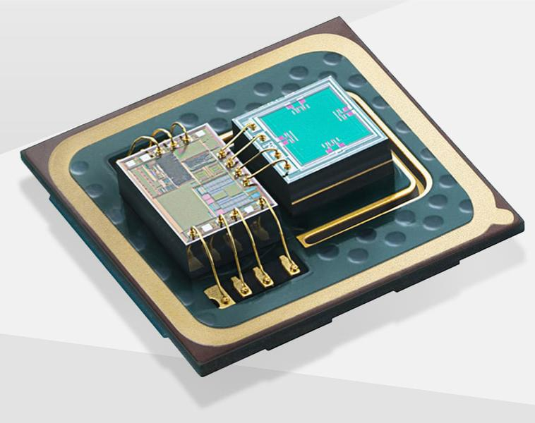
PROPOSED SYSTEM
In proposed system we have using Mems sensor to converts sign language to voice as well as displays text in LCD display of controller . A gesture based circuit is designed to express the need of speechless patient & physically challenged people. The pre-determined gesture is stored in microcontroller to process what types of gesture is generating and expressed thought is announce as voice.

Slide 10
ADVANTAGES
A gesture based circuit is used for speechless patient & physically challenged people.
Pre-determined gesture is used to express their thoughts and announced as voice.
It is requires fewer components so its cost is low

Slide 11
BLOCK DIAGRAM
POWER SUPPLY
ARDUINO
UNO
LCD DISPLAY
MEMS SENSOR 1
VOICE MODULE
MEMS SENSOR 2
SPEAKER

Slide 12
MODULES
OUTPUT 1:
The Mems sensor to measure the angle of hand movement then transfer the data’s to Arduino Microcontroller.
OUTPUT 2:
The pre-determined gesture is stored in microcontroller to process what types of gesture is generating and expressed thought is announce as voice and text .

Slide 13
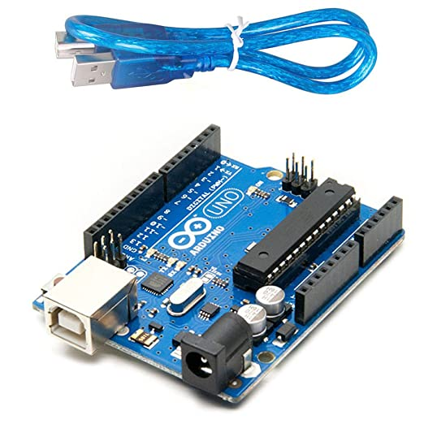
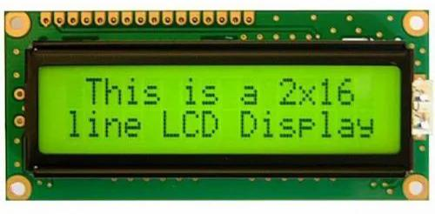
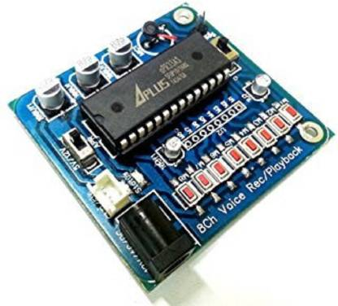
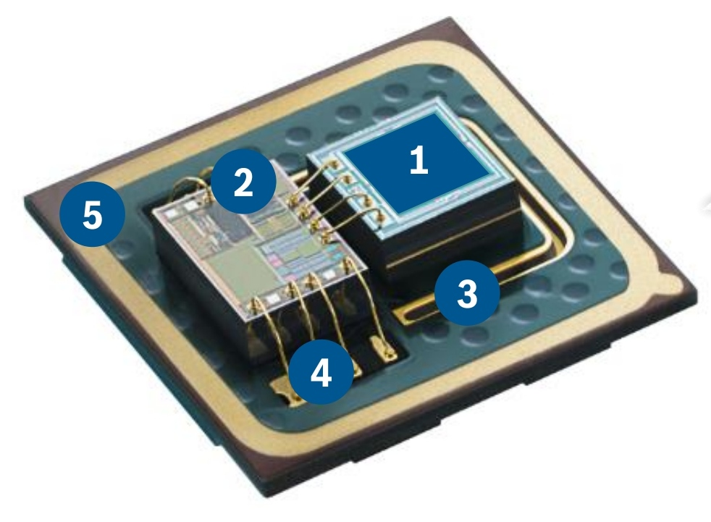
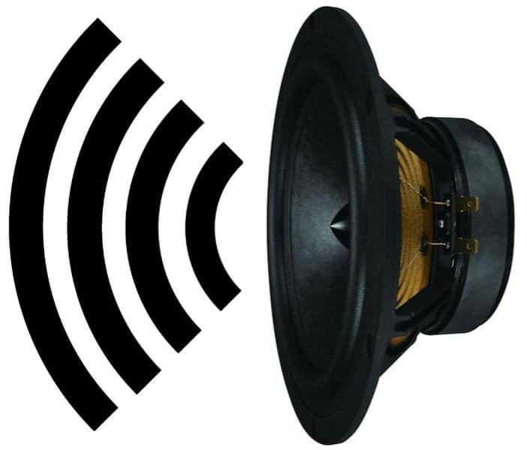
HARDWARE REQUIREMENTS
Arduino UNO
Mems sensor
LCD Display
APR Voice module
Speaker
Power supply

Slide 14
SOFTWARE REQUIREMENTS
Arduino IDE
Embedded C

Slide 15
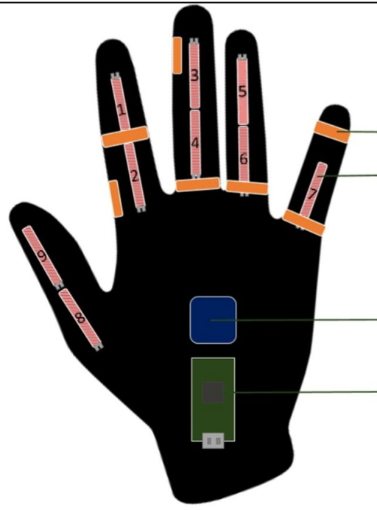
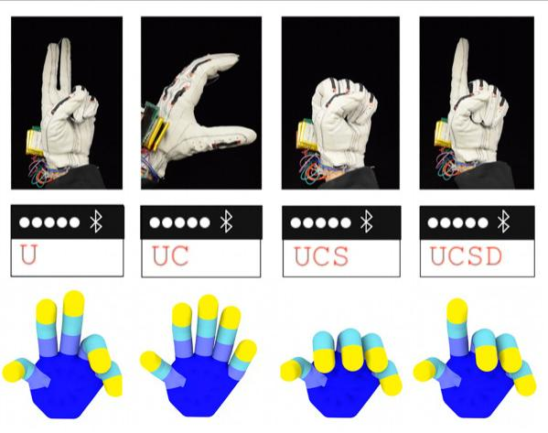
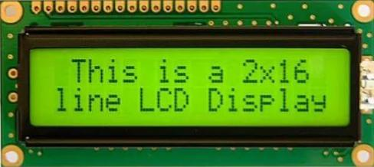
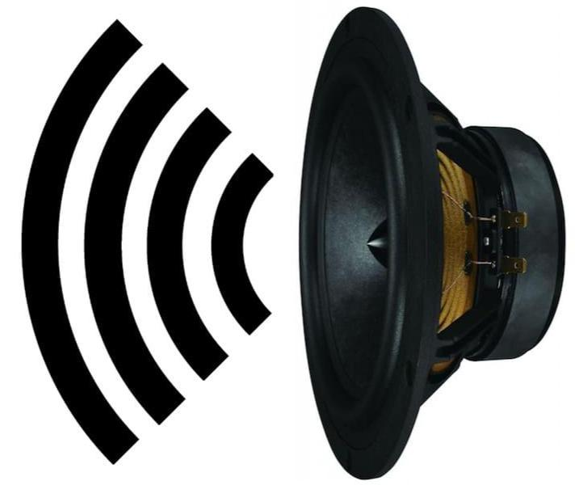
EXPECTED OUTCOME

Slide 16
FUTURE WORK
Future system improvements will increase efficiency. then to record a video for data collection and utilize image processing techniques to quickly identify the sign language. The Arduino can be interfaced to a Android through a Bluetooth module for displaying the output, which would be easy to view and also it reduces the weight of the glove.

Slide 17
CONCLUSION
This technique allows deaf, dumb, and blind persons to communicate with one another. Dumb people speak in their own language, which is difficult for blind and conventional people to understand. The sign language is also translated into a written format to help deaf people. This text appears on a screen. Deaf people must be recovered. We'll using it to observe the hand motions for the deaf and blind. Hand movements are converted to text and then to voice by the system. If a person cannot hear the sound made due to those difficulties, a provision has been implemented into the text system so that the person still read and understand what the other person is trying to say.

Slide 18
REFERENCE
Ali, S. Munawwar, B. Nadeem, “Electroni Speaking Glove for Speechless Patients”, August 2010, Bachelor of Electronic Engineering FYP Report, FEST, HIIT, Hamdard University, Karachi, Pakistan
N. P. Bhatti, A. Baqai, B. S. Chowdhry, M. A. Unar, “Electronic Hand Glove for Speech Impaired and Paralyzed Patients”, EIR Magazine, May 2009, pp. 59-63, Karachi,Pakistan
B. B. Edin, L. Ascari, L. Beccai, S. Roccella, J. J. Cabibihan,M. C. Carrozza, “Bio-Inspired Sensorization of a Biomechatronic Robot Hand for the Graspand-Lift Task”, Brain Research Bulletin, Volume 75, Issue 6, 15 April 2008, pp. 785-795 [CrossRef]
M. Wald, “Captioning for Deaf and Hard of Hearing People by Editing Automatic Speech Recognition in Real Time”, Proceedings of 10th International Conference on Computers Helping People with Special Needs ICCHP 2006, LNCS 4061, pp. 683-690

Slide 19
THANK YOU

